Slide 1
Running Production Hyper-V and vSphere ESXi A user comparison

Slide 2
Get-Disclaimer | Write-Host
Before we begin –
Work require me to remain anonymous
My experience is derived from the setup and our needs – mileage may vary
Opinions are subjective though you can totally trust mine ☺
This journey covers a five year period
Much has changed and I am aware some of the opinions and statements I will make would no longer be valid on current/future deployments

Slide 3

PS C:\> $env:USERNAME Alex Bytes
Senior engineer for [super secret] organisation
Looks after ‘all the things’
Small team managing pretty much everything
Blogger of IT
bytesizedalex.com - Byte sized for when a nibble just isn't enough!
Twitter - @bytesizedalex

Slide 4
Get-Agenda
Some thoughts and experiences comparing the two products
5 years of events and experience is difficult to condense
Shortened version of this talk so we will move pretty quick
Time for questions at the end but please feel free to wave your arms around enthusiastically if you have any during the talk

Slide 5

How did we end up with two hypervisors?

Slide 6

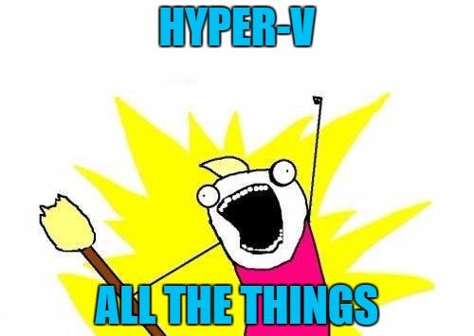
“I’ve heard this Hyper-V thing is totally awesome. We should definitely deploy it in production. Also Microsoft say it is free!”

Slide 7
Management Goals
Hyper-V was to replace ESXi
Identified as a cost saving – no need for VMware licensing
Existing ESXi to only exist long enough for us to migrate away
ESXi cluster not to be grown
We have a large Enterprise Agreement (EA) with Microsoft so the logic was understandable

Slide 8

Team Reaction To Hyper-V News

Slide 9
Setup
VMware ESXi | Microsoft Hyper-V
vSphere 5.5 (6.5U1 now) | Server 2012 R2 Core Edition
All hosts in one cluster | Two clusters – SQL and ‘anything else’
DRS Rules for VM placement | Possible and Preferred owners
ALUA / Peer Persistence | CSVs using CLX extension software
A second ESXi cluster exists at our third DC – this hosts our witness appliances and file share witness for Microsoft Failover Clusters
Important note – some of our witness appliances could only be deployed on ESXi

Slide 10
Active-Active DCs
Roughly 21KM apart
High bandwidth, low latency DWDM between sites

Slide 11
Systems Management
Managing our Hyper-V estate regularly requires us to jump between
Hyper-V Manager
System Center Virtual Machine Manager
Failover Cluster Manager
Local host access/PowerShell
Managing our VMware estate requires vCenter…

Slide 12
Deployment Methods
ESXi allows for
SD Card
SATA DOM
Stateless deployment – ‘boot from SAN’ etc
Hyper-V required us to add hard drives to blades
2 drives in a RAID 1 – therefore with all blades being purchased identically we had this setup in both Hyper-V and ESXi
If we had deployed the blades with SSD drives we could have used those in ESXi as a local read cache
While the cost difference is relatively low it does add up as you scale nodes

Slide 13
Monitoring
vCenter gives you a wealth of information
Yes we can use vROPS but it is not required nor do they hamstring vCenter to try and make you purchase a suite of products
Microsoft clearly expect you to leverage the System Center suite as SCVMM monitoring options/data is rubbish
We did push the SCOM agent to our hosts… recent Microsoft support case had us removing it as it was causing WMI issues
Large scale SolarWinds deployment already in place so we leverage this as our ‘single pane of glass’ view

Slide 14
Stability
The complexity of our environment has resulted in some fascinating fault scenarios to troubleshoot
ESXi has never let us down
Hyper-V… let’s just say it hasn’t been quite as reliable
Example:
WMI issues (e.g provider load failure) prevent MS management tools being able to talk to the cluster which is ‘fun’
Some of the Hyper-V issues could be attributed to architectural decisions which were forced on us due to vendor support/qualification of Hyper-V at time of deployment

Slide 15
Lessons Learnt 1/2
Running two hypervisors adds cost and complexity
Most vendors would build/support products on ESXi hampering management goal of removing it from the business
Some hardware vendors solutions are certainly more mature on ESXi and produce better results e.g Peer Persistence > CLX
Documentation overhead due to the differences in each setup
Economies of scale cannot be realised nor can efficiencies in processes
VMware is more reliable and stable
We had to put less work into the product to achieve our end goals
Some of this is due to the deployment differences but not all of it

Slide 16
Lessons Learnt 2/2
Security was more of a challenge than necessary
Designing our next ‘VDC’ is going to be more challenging
A decision needs to be made on whether to keep both hypervisors
Capacity planning is more challenging as you can’t be sure which platform a vendor will support or request
We can pretty much say ESXi is always supported and as such I would consider it the preferred option if I had to pick one hypervisor

Slide 17
Thinking of making a change?
Try and run one product as it will simplify your setup
If you intend to add another first understand how the product aligns with your strategy – what will it bring that helps you achieve business goals?
Have clearly defined objectives and metrics to measure success against
Do not rely on subjective opinions as your only measure
Engage with the community – ask if you can visit organisations who have been through this process, speak with their engineers
Do not look to others to give you your ‘right answer’ – do your own homework

Slide 18
Questions

Slide 19
Feedback
Feedback is truly valued; either directly or via the team at TechUG

